Slide 1
Presentation 2
Min Li

Slide 2
Cluster validity
Cluster Error
is associated with any U ∈ M_{c}
it is the number of vectors in X that are mislabeled by U
E(U) is an absolute measure of cluster validity
when X is labeled,
and is undefined when X is not labeled.

Slide 3
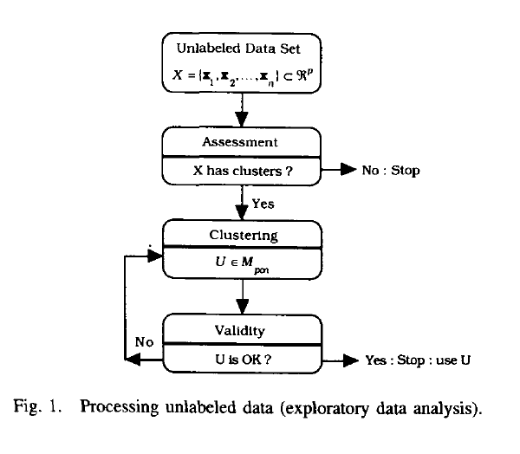
Cluster Validity
Process unlabeled data

Slide 4
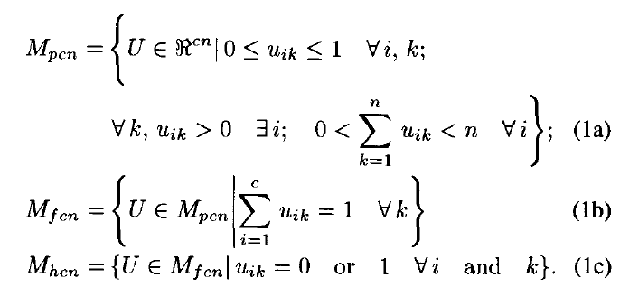
Cluster validity
Some Symbol
X : {X1,X2,…,Xn}
U = {Uik} : c partitions of X are sets of (cn) values {Uik} that can be conveniently array. There are three sets of partition matrices

Slide 5
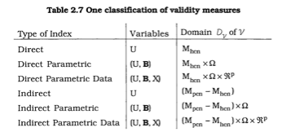
Cluster Validity
classification of validity measures
Direct Measure: Davies-Bouldin Index, Dunn’s index
Indirect measures for fuzzy clusters: degree of separation, partition coefficient and partition entropy. Xie and Beni index

Slide 6
Fuzzy Logic
Fuzzy logic is a form of many-valued logic
Approximate rather than fixed and exact
True value range in degree between 0 and 1
How could we define empty or full?

Slide 7
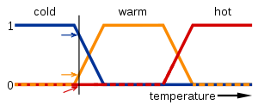
Fuzzy Logic
example
A temperature measurement for anti-lock brakes
The meaning of expression “cold”, “warm” and “hot” is represented by functions mapping a temperature scale. A point on that scale has three “true value”

Slide 8
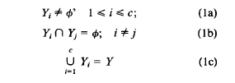
FCM： The Fuzzy c-Means Clustering Algorithm
Vs conventional c-partition
Y = {y1,y2,…,yN}
Partition is a c-tuple(Y1,Y2,…Yc) of subset of Y satisfies three conditions:
Hard partitions are a special type of Fuzzy ones

Slide 9
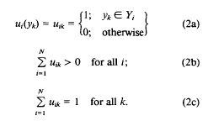
Fuzzy Clustering
recast the conditions in matrix-theoretic terms and let U be a real c * N matrix, U=[uik]
U is the matrix representation of the partition {Yi}

Slide 10

Fuzzy Clustering
Clustering criteria
M: weighting exponent controls the relative weights placed on each of the squared errors
Weight Matrix A: the matrix controls the shape that optimal cluster.

Slide 11
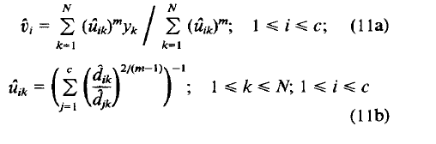
Fuzzy Clustering
Optimal Fuzzy Clustering

Slide 12
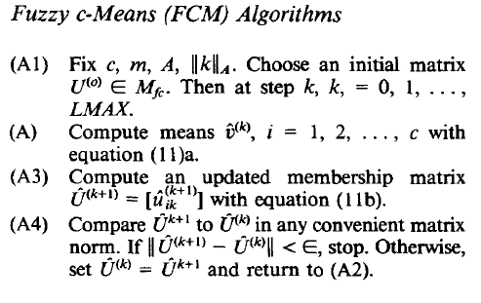
Fuzzy Clustering
Algorithm

Slide 13
Cluster validity
The global minimum of J_{w} may suggest the “wrong” 2-clusters
Example from Bezdek: n=29 data vectors {x_{k}}⊂R² “correct” 2-partition of X is shown on the left
The global minimum is
hardly an attractive solution.
X
s
For hard 2-partition ,
For hard 2-partition ,

Slide 14
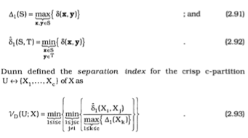
Cluster Validity
Dunn’s Validity Index
This technique (Dunn, 1974) is based on geometric considerations that has the same basic rationale as Vdb,qt in that both are designed to identify volumetric clusters that are compact and well separated.

Slide 15
Cluster Validity
Comment for Dunn’s Validity Index
Large values of Vd correspond to good clusters. Hence, the number of clusters that maximizes Vd is taken as the best solution. Vd is not defined on 1n when c=1 or on In when c=n.

Slide 16
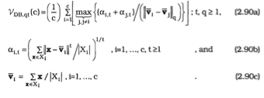
Cluster Validity
Davies-Bouldin Validity Index
This index (Davies and Bouldin, 1979) is a function of the ratio of the sum of within-cluster scatter to between-cluster separation.

Slide 17
Cluster Validity
Comment for Davies-Bouldin Validity Index
VDB,qt(11*n) is undefined and VDB,qt(1)=0
Low values are taken as indicants of good cluster structure.

Slide 18
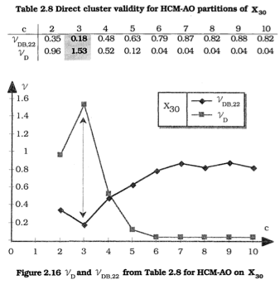
Sample

Slide 19
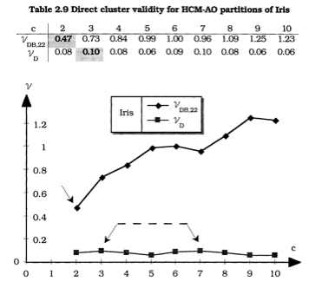
Sample

Slide 20

Cluster Validity
Silhouette Validation Method
The Silhouette validation technique (Rousseeuw, 1987) calculates the silhouette width for each sample

Slide 21

Cluster Validity
Jaccard index
In this index (Jaccard, 1912), which has been commonly applied to assess the similarity between different partitions of the same dataset, the level of agreement between a set of class labels C and a clustering result K is determined by the number of pairs of points assigned to the same cluster in both partitions.

Slide 22

Cluster Validity
Rand index
This index (Rand, 1971) simply measures the number of pairwise agreements between a clustering K and a set of class labels C, normalised so that the value lies between 0 and 1

Slide 23
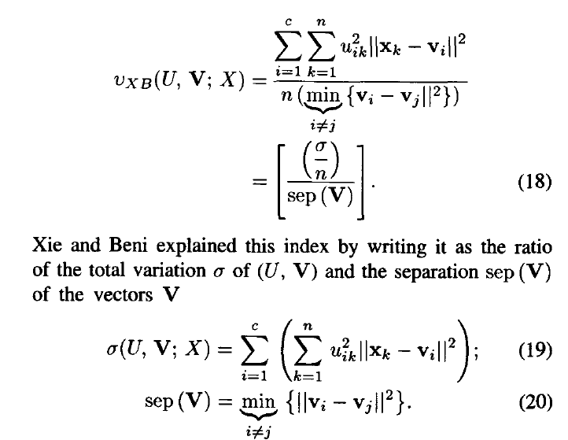
Cluster Validity
Xie-Beni index

Slide 24
Cluster Validity
Xie-Beni index
A good (U,V) pair should produce a small value of δ because uik is expected to be high when |xk-vi| is low. And well-separated vi’s will produce a high value of sep(V)

Slide 25
Degree of Separation - Bezdek
Example: c=2 and two different fuzzy 2-partitions of X:
Z(U;2) = Z(V;2) = 0.50
U and V are very different so Z does not distinguish between the two partitions.

Slide 26
Partition Coefficient - Bezdek
U is a fuzzy c-partition of n data points. The partition coefficient, F, of U, is the scalar:
The value of F(U;c) depends on all (c x n) elements of U in contrast to Z(U;c) that depends on just one.

Slide 27
Partition Coefficient - Bezdek
Example: values of F on U and V partitions of X:
F(U;2) = 0.510
F(V; 2) = 0.990
The value of F gives accurate indication of the partition, for both the most uncertain and certain states.

Slide 28
Partition Coefficient - Bezdek
from Bezdek

Slide 29
Partition Coefficient - Bezdek
Values of F(U;c) for c = 2, 3, 4, 5, 6 with the norms N_{E}, N_{D} and N_{M}
F first identifies a primary structure at c* = 2;
and then the secondary structure at c = 3
 | Norm
c | N_{E} | N_{D} | N_{M}
2 | 0.88 | 0.89 | 0.56
3 | 0.78 | 0.80 | 0.46
4 | 0.71 | 0.71 | 0.36
5 | 0.66 | 0.68 | 0.31
6 | 0.60 | 0.62 | 0.37

Slide 30
Partition Entropy - Bezdek
Let {A_{i} | 1 ≤ i ≤ c } denote a c-partition of events of any sample space connected with an experiment; and let
p^{T} = (p₁,p₂, …, p_{c})
denote a probability vector associated with the {A_{i}}.
The pair ({A_{i}}, p) is called a finite probability scheme for the experiment
i^{th} component of p is the probability of event A_{i}
c is called the length of the scheme
Note: c does NOT indicate the number of clusters

Slide 31
Partition Entropy - Bezdek
Our aim is to find a measure h(p) of the amount of uncertainty associated with each state.
h(p) – should maximize for p=(1/c, …, 1/c)
h(p) – should minimize for p=(0, 1, 0, …) (any partition statistically certain)

Slide 32
Partition Entropy - Bezdek
The entropy of the scheme is defined as:
p_{i} log_{a}(p_{i}) = 0 whenever p_{i} = 0

Slide 33
Partition Entropy - Bezdek
Partition entropy
of any fuzzy c-partition U ∈ M_{fc} of X,
where |X| = n, is, for 1 ≤ c ≤ n

Slide 34
Partition Entropy - Bezdek
Let U ∈ M_{fc} be a fuzzy c-partition of n data points. Then for 1 ≤ c ≤ n and a ∈ (1,∝)
0 ≤ H(U;c) ≤ log_{a}(c)
H(U;c) = 0 ⇔ M_{co} is hard
H(U;c) = log_{a}(c) ⇔ U = [1/c]

Slide 35
Partition Entropy - Bezdek
Example: entropy for U and V
H(U;c) = 49 log_{e}(2)/51 = 0.665
H(V;c) = log_{e}(2)/51 = 0.013
U is a very uncertain partition

Slide 36
Partition Entropy - Bezdek
Normalized partition entropy:
Reasons: Variable ranges make interpretation of values of Vpc and Vpe difficult. Since they are not referenced to a fixed scale.
For example

Slide 37
Partition Entropy - Bezdek
Normalized partition entropy:

Slide 38

Cluster Validity
Comment for partition coefficient and partition entropy
Vpc maximizes (and Vpe minimizes) on every crisp c-partition of X. And at the other extreme, Vpc takes its unique minimum( and Vpe takes its unique maximum) at the centroid U =[1/c]= U of Mfcn. U The “fuzziest” partition you can get since it assigns every point in X to all c classes with equal membership values 1/c.

Slide 39
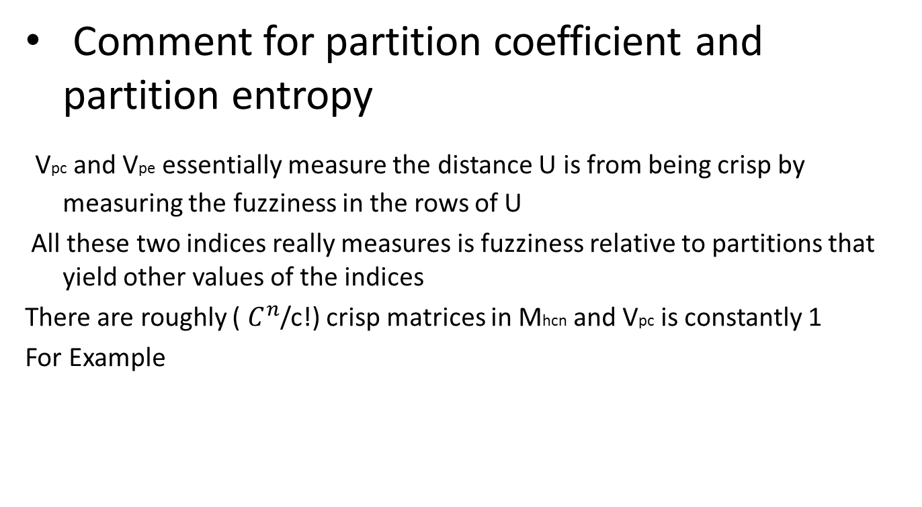
Cluster Validity
Comment for partition coefficient and partition entropy
Vpc and Vpe essentially measure the distance U is from being crisp by measuring the fuzziness in the rows of U
All these two indices really measures is fuzziness relative to partitions that yield other values of the indices
There are roughly ( $C^{n}$/c!) crisp matrices in Mhcn and Vpc is constantly 1
For Example

Slide 40
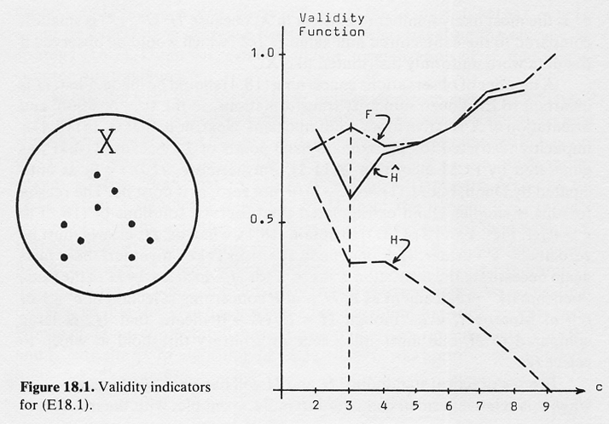
from Bezdek

Slide 41
Prototypes for FEATURE SELECTION from Bezdek
Symptom | Feature centers |  | Absolute differences
 | (Hernia) v_{1j} | (Gallstones) v_{2j}
1 | 0.57 | 0.27 | 0.30
2 | 0.98 | 0.67 | 0.31
3 | 0.06 | 0.93 | →0.87
4 | 0.22 | 0.55 | 0.33
5 | 0.17 | 0.10 | 0.07
6 | 0.77 | 0.84 | 0.07
7 | 0.42 | 0.05 | 0.37
8 | 0.39 | 0.84 | 0.45
9 | 0.48 | 0.04 | 0.44
10 | 0.02 | 0.16 | 0.14
11 | 0.12 | 0.25 | 0.13

Slide 42
Cluster Errors for FEATURE SELECTION from Bezdek
Symptoms used | Cluster Error E(U)
{1-11} | 23
{3} | 23
{3, 8} | 23
{3, 9} | 36
{3, 8, 9} | 36

Slide 43
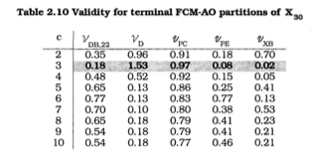
Cluster Validity
Example

Slide 44
Cluster Validity
Divisive Coefficient (DC)
a
a,b
b
a,b,c,
d,e
c
c,d,e
d,e
d
e
10.0
5.0
3.0
2.0
0.0

Slide 45
Cluster Validity
Divisive Coefficient
For each object i, let d ( i ) denote the diameter of the last cluster to which it belongs (before being split off as a single object), divided by the diameter of the whole data set.
The divisive coefficient (DC), given by
DC=(

Slide 46
Cluster Validity
C- number of clusters being included

Slide 47
Cluster Validity
Divisive Coefficient (DC)
a
l₇
a,b
l₂
b
l₈
a,b,c,
d,e
l₀
c
c,d,e
l₄
l₁
d,e
d
l₅
l₃
e
l₆
10.0
5.0
3.0
2.0
0.0
L1=(1-((10-5)/10))3=1.5

Slide 48
Cluster Validity
Divisive Coefficient (DC)
a
l₇
a,b
l₂
b
l₈
a,b,c,
d,e
l₀
c
c,d,e
l₄
l₁
d,e
d
l₅
l₃
e
l₆
10.0
5.0
3.0
2.0
0.0

Slide 49
Cluster Validity
Divisive Coefficient (DC)
a
l₇
a,b
l₂
b
l₈
a,b,c,
d,e
l₀
c
c,d,e
l₄
l₁
d,e
d
l₅
l₃
e
l₆
10.0
5.0
3.0
2.0
0.0

Slide 50
Cluster Validity
Divisive Coefficient (DC)
a
l₇
a,b
l₂
b
l₈
a,b,c,
d,e
l₀
c
c,d,e
l₄
l₁
d,e
d
l₅
l₃
e
l₆
10.0
5.0
3.0
2.0
0.0

Slide 51
Cluster Validity
Divisive Coefficient (DC)
a
l₇
a,b
l₂
b
l₈
a,b,c,
d,e
l₀
c
c,d,e
l₄
l₁
d,e
d
l₅
l₃
e
l₆
10.0
5.0
3.0
2.0
0.0

Slide 52
Cluster Validity
How to assess the quality of clusters?
How many clusters should be found distinguished in data?

Slide 53
Cluster Validity: Davies-Bouldin index

Slide 54
Cluster Validity: Dunn separation index

